Slide 1
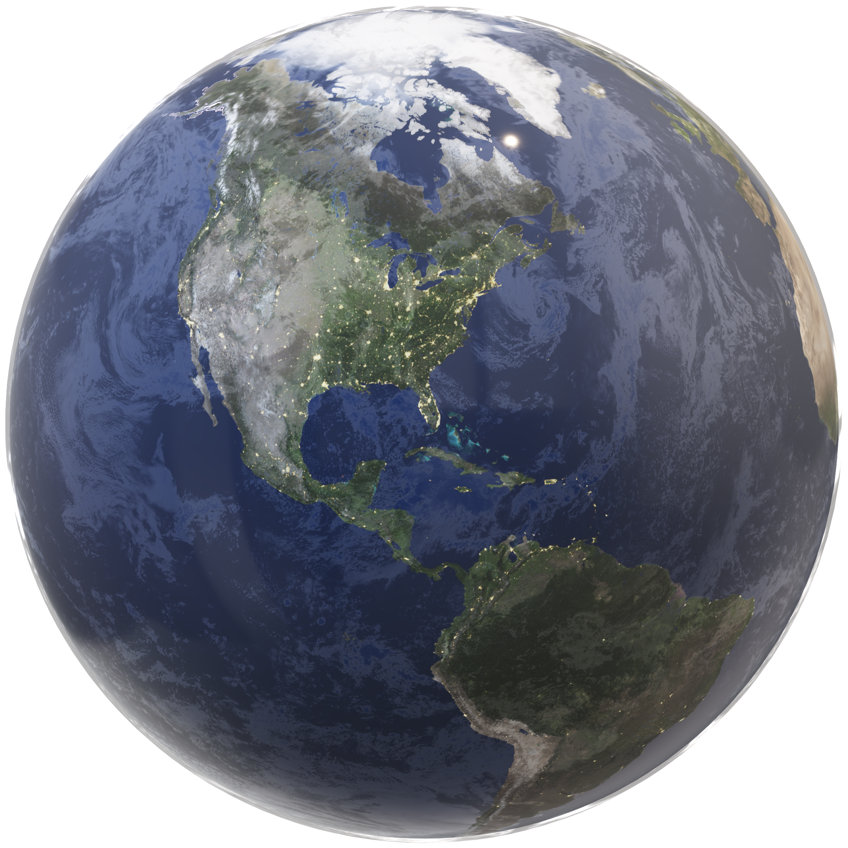
DATA SCIENCE
OBJECT DETECTION AI
FRAUD DETECTION
PROCESS AUTOMATION
OPTIMIZATION
SYSTEMS SOLUTION DESIGN
INTERACTIONS OF PEOPLE< PROCESS AND POLICIES
SYSTEM INTEGRATION
OPEN SOURCE SYSTEMS DESIGN
ANALYTICAL SOFTWARE DEV
CLOUD – DESKTOP – ON PREMISE
INTERACTIVE WEB APPLICATIONS
COMMON OPERATING PICTURE
GEOSPATIAL ANALYTICS
SPACE IMAGING ANALYSIS
GEOSPATIAL DATA INFRASTRUCTURE
RESOURCE ALLOCATION
GEOPROCESSING AUTOMATION

Slide 2
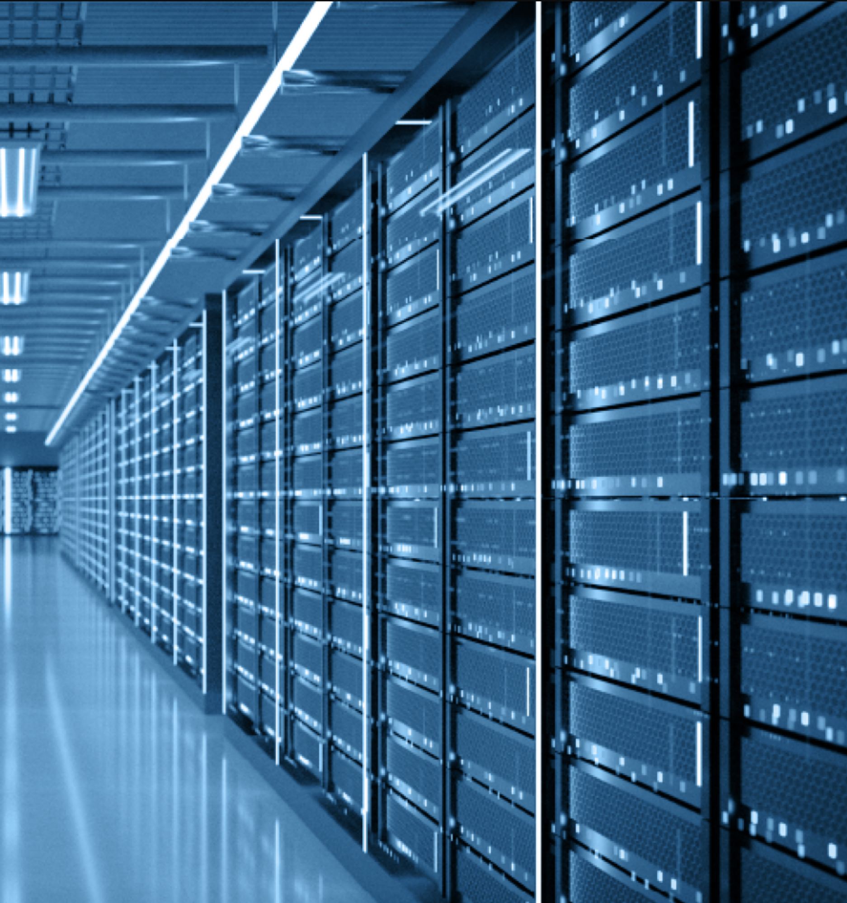

SYSTEMS SOLUTION DESIGN
INTERACTIONS OF PEOPLE< PROCESS AND POLICIES
SYSTEM INTEGRATION
OPEN SOURCE SYSTEMS DESIGN
DATA SCIENCE
OBJECT DETECTION AI
FRAUD DETECTION
PROCESS AUTOMATION
OPTIMIZATION
ANALYTICAL SOFTWARE DEV
CLOUD – DESKTOP – ON PREMISE
INTERACTIVE WEB APPLICATIONS
COMMON OPERATING PICTURE
GEOSPATIAL ANALYTICS
SPACE IMAGING ANALYSIS
GEOSPATIAL DATA INFRASTRUCTURE
RESOURCE ALLOCATION
GEOPROCESSING AUTOMATION

Slide 3
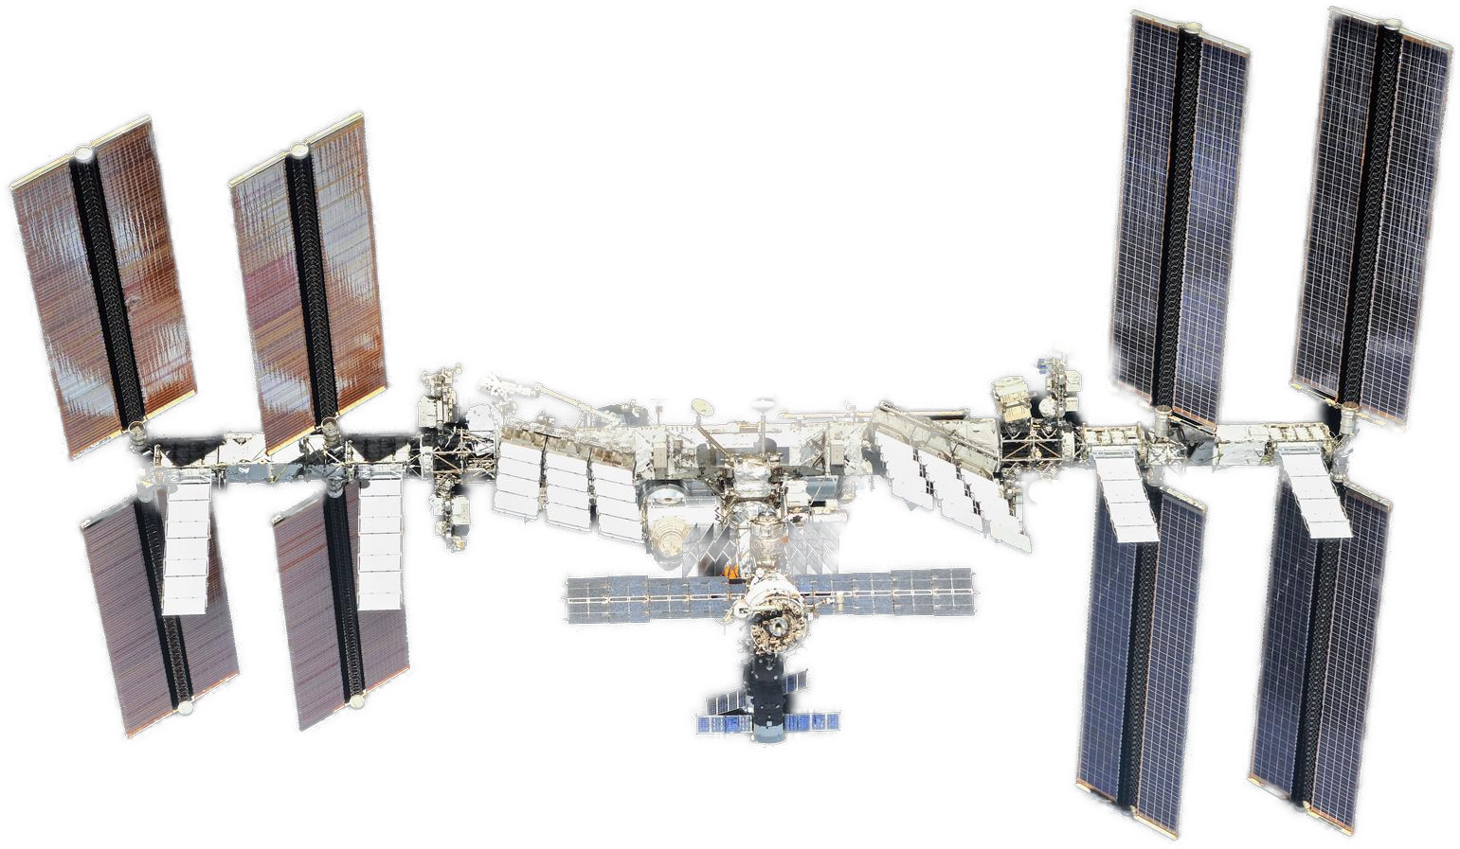
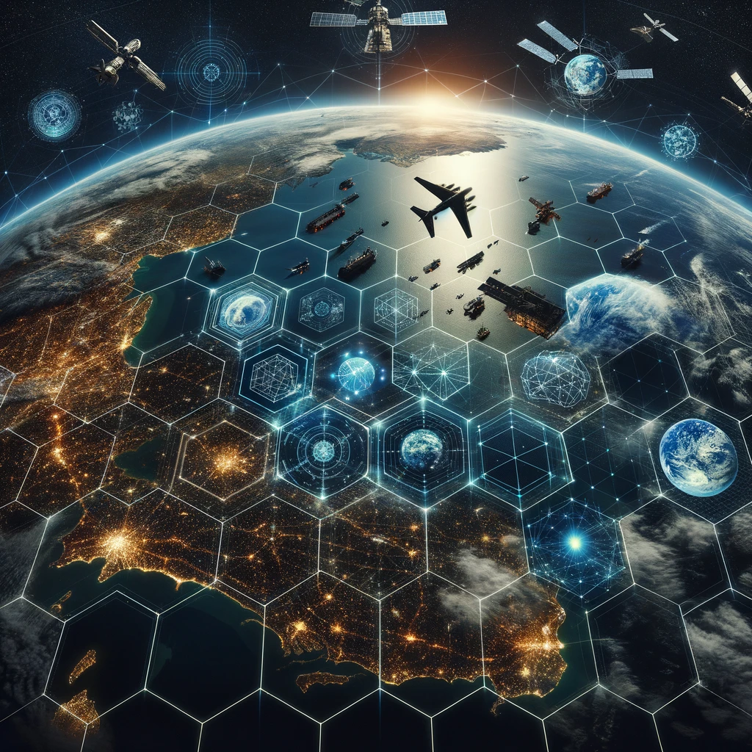
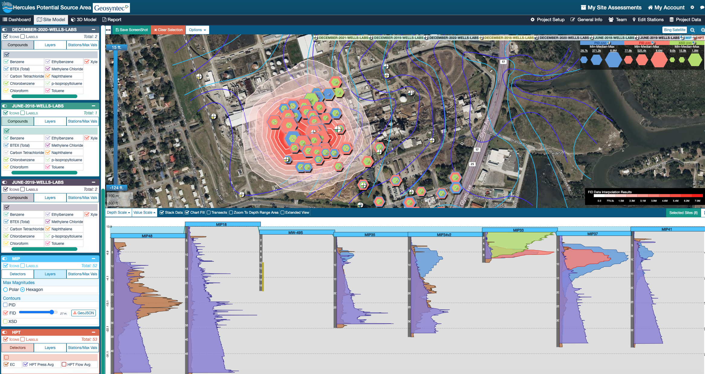
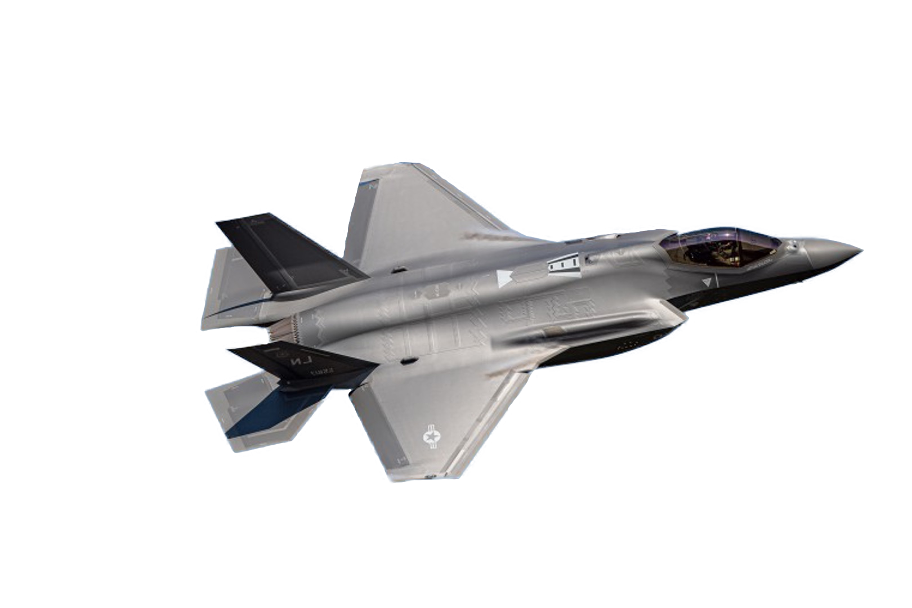
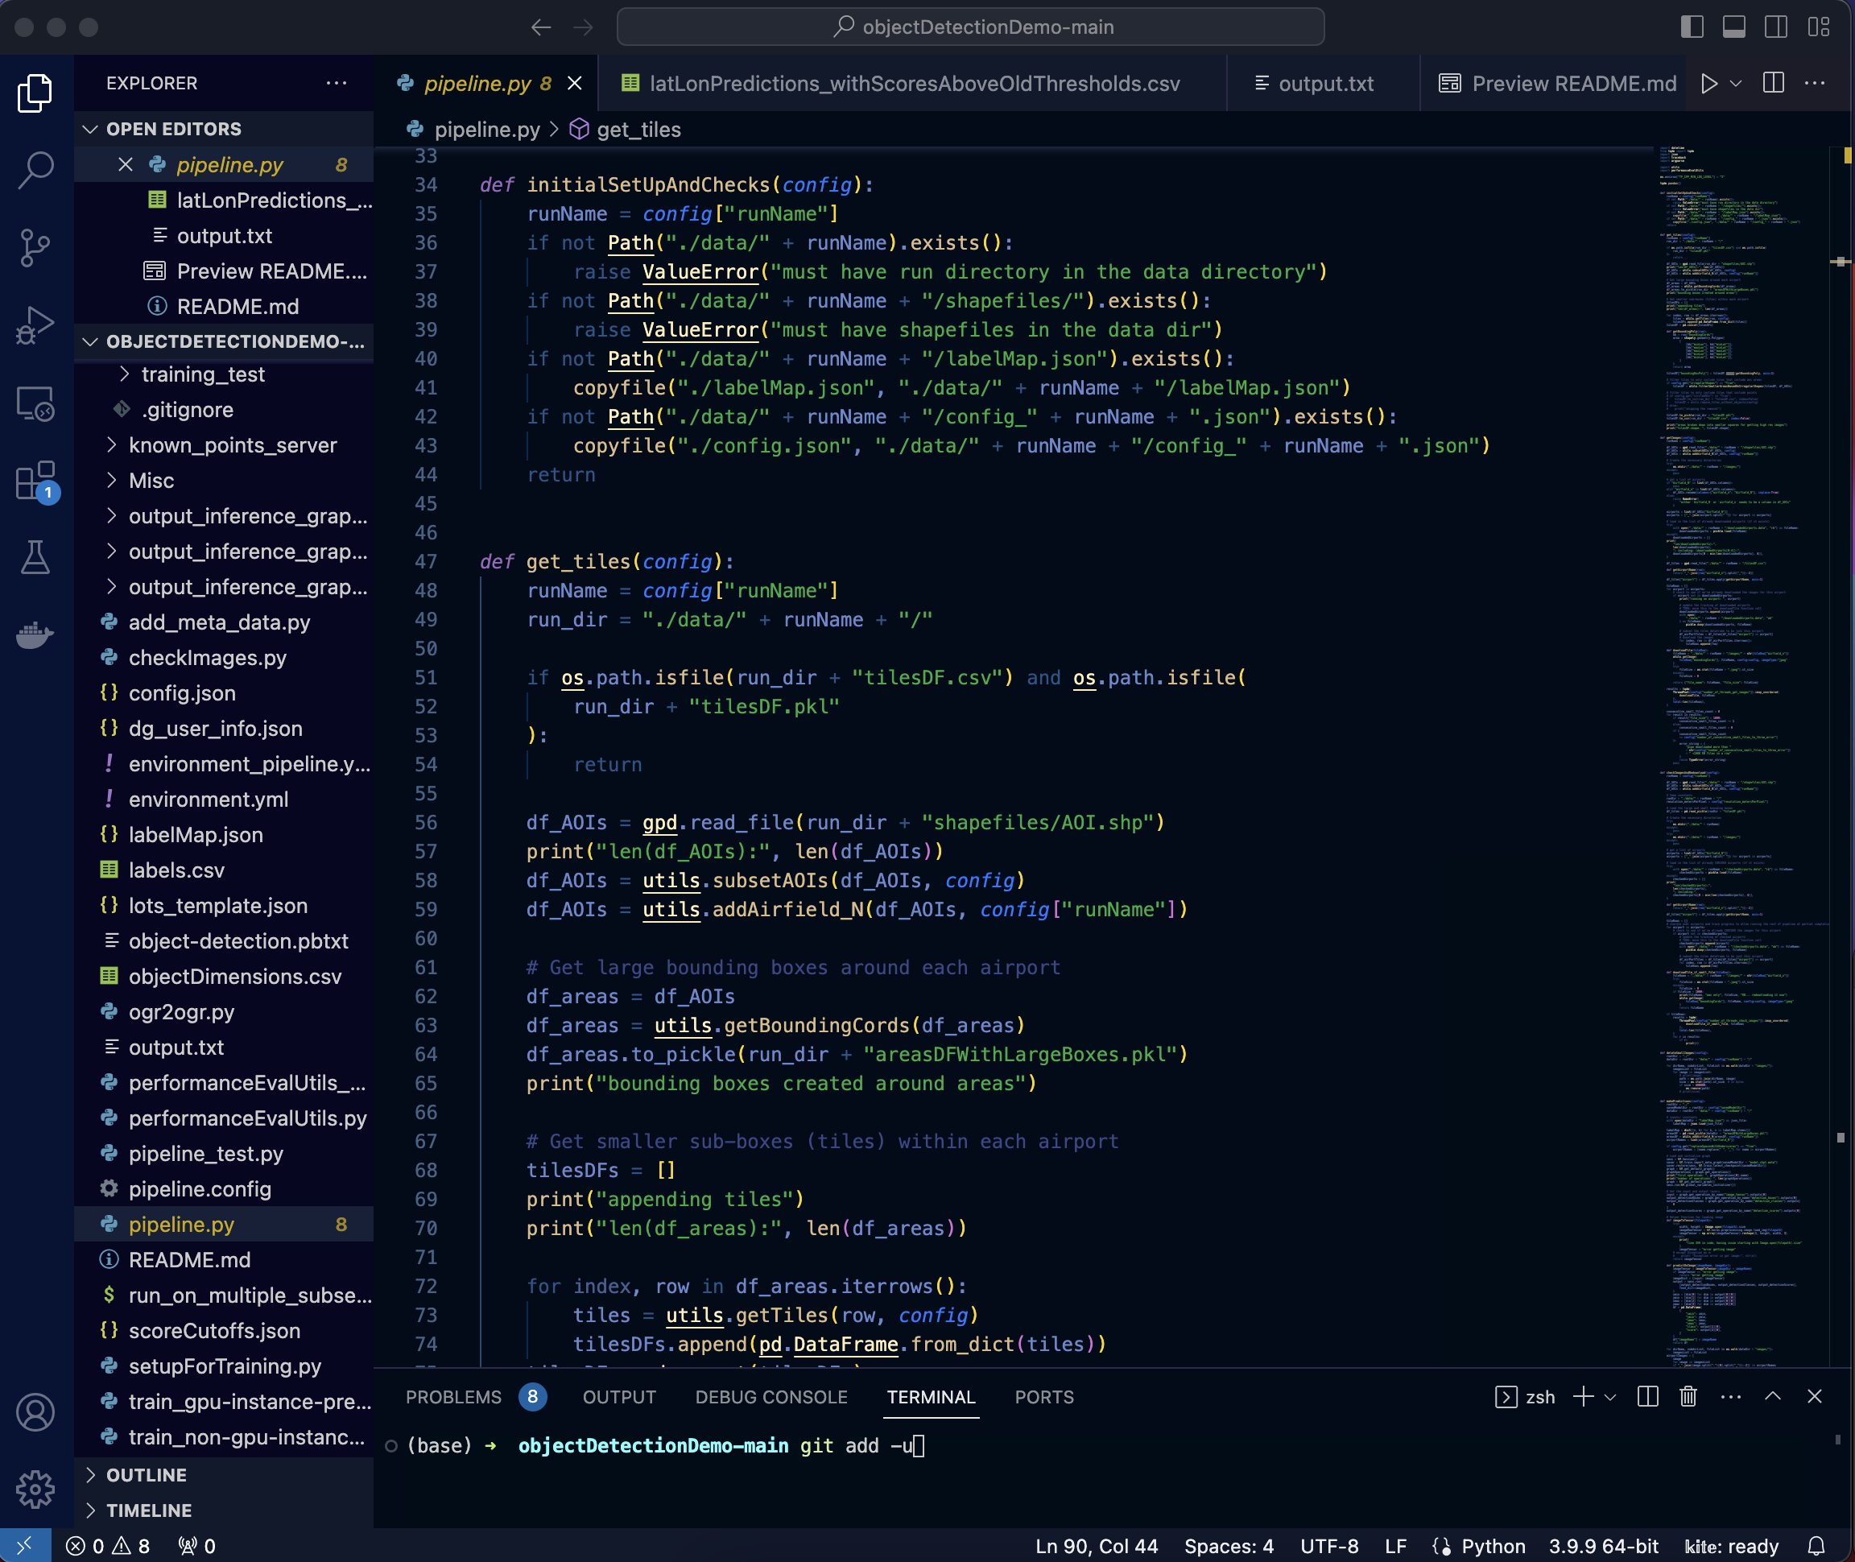
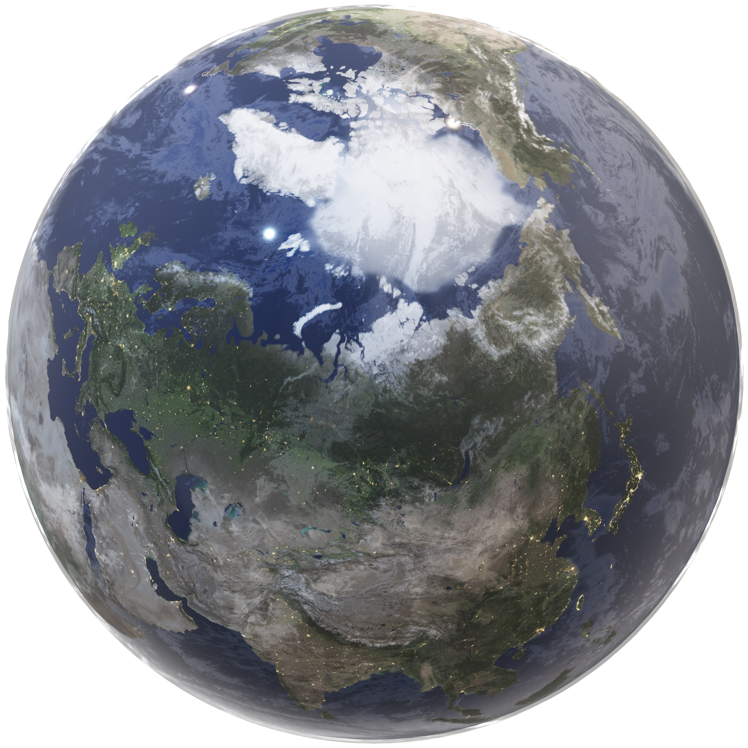
DATA SCIENCE
OBJECT DETECTION AI
FRAUD DETECTION
PROCESS AUTOMATION
OPTIMIZATION
SYSTEMS SOLUTION DESIGN
ANALYTICAL SOFTWARE DEV
INTERACTIONS OF PEOPLE< PROCESS AND POLICIES
SYSTEM INTEGRATION
OPEN SOURCE SYSTEMS DESIGN
CLOUD – DESKTOP – MOBILE - ON PREMISE
INTERACTIVE WEB APPLICATIONS
COMMON OPERATING PICTURE
GEOSPATIAL ANALYTICS
SPACE IMAGING ANALYSIS
GEOSPATIAL DATA INFRASTRUCTURE
RESOURCE ALLOCATION
GEOPROCESSING AUTOMATION

Slide 4
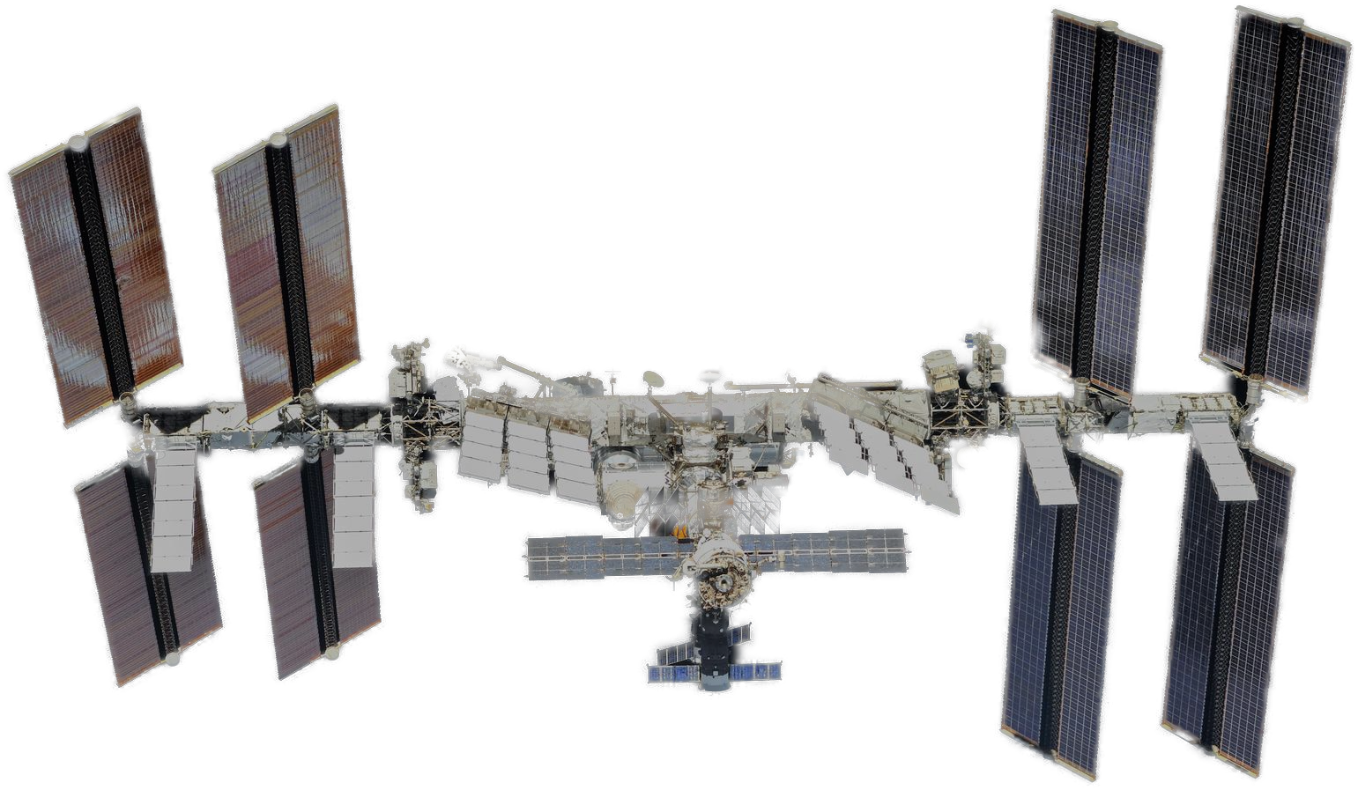
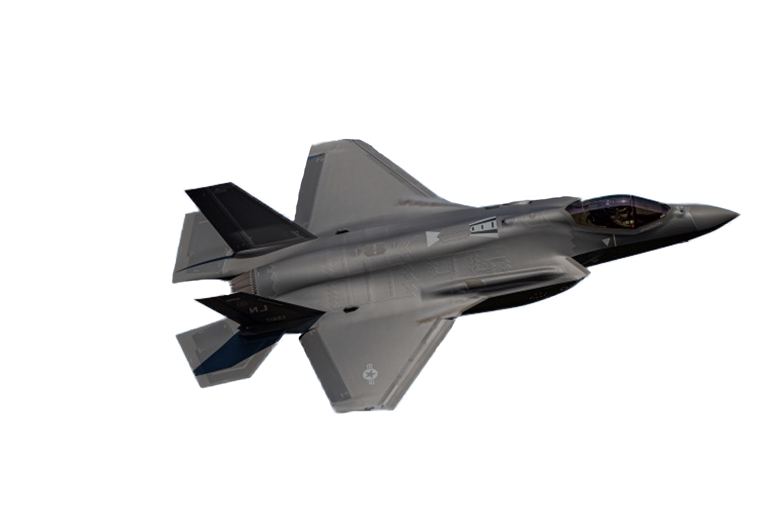

GEOSPATIAL ANALYTICS
SPACE IMAGING ANALYSIS
GEOSPATIAL DATA INFRASTRUCTURE
RESOURCE ALLOCATION
GEOPROCESSING AUTOMATION
SYSTEMS SOLUTION DESIGN
INTERACTIONS OF PEOPLE PROCESS AND POLICIES
SYSTEM INTEGRATION
CYBERSECURITY
DATA SCIENCE
OBJECT DETECTION AI
FRAUD DETECTION
PROCESS AUTOMATION
OPTIMIZATION
ANALYTICAL SOFTWARE DEV
CLOUD – DESKTOP – ON PREMISE
INTERACTIVE WEB APPLICATIONS
COMMON OPERATING PICTURE

Slide 5
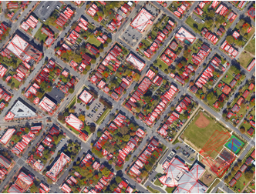

DATA SCIENCE
OBJECT DETECTION AI
FRAUD DETECTION
PROCESS AUTOMATION
OPTIMIZATION
SYSTEMS SOLUTION DESIGN
GEOSPATIAL ANALYTICS
INTERACTIONS OF PEOPLE< PROCESS AND POLICIES
SYSTEM INTEGRATION
OPEN SOURCE SYSTEMS DESIGN
SPACE IMAGING ANALYSIS
GEOSPATIAL DATA INFRASTRUCTURE
RESOURCE ALLOCATION
GEOPROCESSING AUTOMATION
ANALYTICAL SOFTWARE DEV
CLOUD – DESKTOP – ON PREMISE
INTERACTIVE WEB APPLICATIONS
COMMON OPERATING PICTURE

Slide 6

DATA SCIENCE
OBJECT DETECTION AI
FRAUD DETECTION
PROCESS AUTOMATION
OPTIMIZATION
SYSTEMS SOLUTION DESIGN
INTERACTIONS OF PEOPLE< PROCESS AND POLICIES
SYSTEM INTEGRATION
OPEN SOURCE SYSTEMS DESIGN
ANALYTICAL SOFTWARE DEV
CLOUD – DESKTOP – ON PREMISE
INTERACTIVE WEB APPLICATIONS
COMMON OPERATING PICTURE
GEOSPATIAL ANALYTICS
SPACE IMAGING ANALYSIS
GEOSPATIAL DATA INFRASTRUCTURE
RESOURCE ALLOCATION
GEOPROCESSING AUTOMATION

Slide 7
DATA SCIENCE
OBJECT DETECTION AI
FRAUD DETECTION
PROCESS AUTOMATION
OPTIMIZATION
SYSTEMS SOLUTION DESIGN
INTERACTIONS OF PEOPLE< PROCESS AND POLICIES
SYSTEM INTEGRATION
OPEN SOURCE SYSTEMS DESIGN
ANALYTICAL SOFTWARE DEV
CLOUD – DESKTOP – ON PREMISE
INTERACTIVE WEB APPLICATIONS
COMMON OPERATING PICTURE
GEOSPATIAL ANALYTICS
SPACE IMAGING ANALYSIS
GEOSPATIAL DATA INFRASTRUCTURE
RESOURCE ALLOCATION
GEOPROCESSING AUTOMATION

